Slide 1
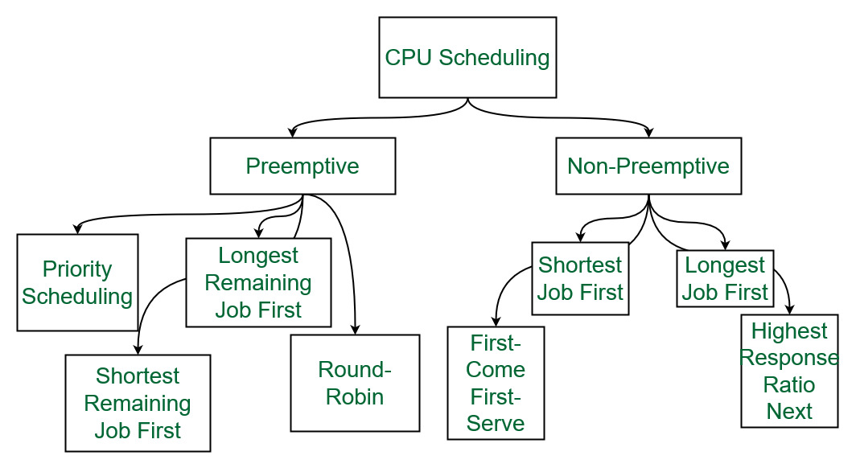
CPU SCHEDULING STARTEGIES
CAPSTONE PROJECT
BY
AASHRITHA ATTADA (192125114)
BHAVANI VALAPALLI(192210198)
LAVU JAITHRA(192210259)
GUDIED BY
DR.G.MARY VALENTINA

Slide 2
AIM:
CPU scheduling efficiently allocates CPU resources among processes in operating systems: Processes enter the ready queue upon arrival, awaiting execution. The scheduler selects processes using algorithms like FCFS, SJN, RR, or Priority Scheduling. Selected processes are dispatched for execution, transitioning to the running state. Execution continues until completion, preemption, or I/O events. Synchronization and preemption optimize CPU utilization, while context switches minimize overhead. Administrators configure scheduling policies to tailor system performance, aiming to optimize resource utilization and responsiveness.

Slide 3
Introduction to CPU Scheduling
CPU Scheduling is the process of organizing and managing the tasks to be performed by the CPU. It involves deciding which processes are to be assigned to the CPU based on certain criteria such as priority and time-sharing. Efficient CPU scheduling strategies are essential for optimal system performance and resource utilization.
The primary goal of CPU scheduling is to ensure that the system makes the best use of its resources, maintains fairness among users, and provides responsive and efficient execution of programs.

Slide 4
Types of CPU Scheduling Strategies
FIRST COME FIRST SERVE (FCFS)
ROUND ROBIN(RR)
SHORTEST JOB NEXT(SJN)
PRIORITY
Each strategy comes with its advantages and limitations, addressing different system requirements and priorities.
These are the 4 types of CPU Scheduling Strategies

Slide 5

FIRST COME FIRST SERVE(FCFS) SCHEDULING
Processes are executed in the order they arrive in the ready queue, with the first process arriving being the first to be served.
FCFS is a non-preemptive scheduling algorithm, meaning once a process starts executing, it continues until it completes its CPU burst voluntarily or blocks for I/O.
FCFS is easy to implement and understand, making it suitable for systems where simplicity is valued.
FCFS ensures fairness since processes are served in the order of their arrival, giving equal priority to all processes.
FCFS can suffer from inefficiencies, particularly the convoy effect, where a long CPU-bound process can hold up shorter processes that arrive later, leading to increased average waiting times.
Example: Imagine a queue at a ticket counter, where the first person in line is served first.

Slide 6
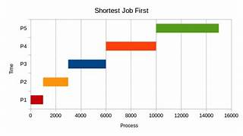
SHORTEST JOB First(SJF) SCHEDILING
Prioritizes processes with the smallest expected burst time for execution, aiming to minimize average waiting time.
Allows a process to run until completion without interruption, potentially leading to longer waiting times for shorter processes.
Allows shorter jobs to preempt longer ones currently running, ensuring optimal utilization of CPU time.
Requires accurate prediction of burst times, which can be challenging in practice due to variations in workload and system behavior.
SJF is optimal in minimizing average waiting time among all scheduling algorithms, assuming burst times are known in advance.

Slide 7
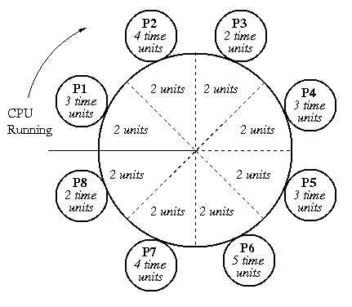
ROUND ROBIN (RR) SCHEDULING
Round Robin (RR) is a preemptive CPU scheduling algorithm where each process is assigned a fixed time quantum to execute before being preempted.
Processes are placed in a circular queue, and the scheduler dispatches the next process in line for execution.
If a process completes within its time quantum, it moves to the end of the queue; otherwise, it's preempted and placed back in the queue.
RR aims to provide fair CPU access to all processes and prevents starvation by ensuring every process gets a turn.
However, short time quanta can lead to high context switch overhead, and longer processes may suffer from increased response times.

Slide 8
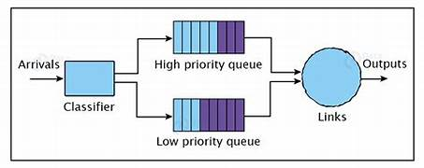
PRIORITY SCHEDULING
Assigns priorities to processes for execution based on factors like importance or system policies.
Processes are executed based on their assigned priority, with higher priority processes taking precedence.
Allows higher priority processes to interrupt lower priority ones for execution, ensuring timely execution of critical tasks.
Risk of lower priority processes never getting CPU time; mitigated using techniques like aging.
Typically realized using data structures like priority queues to efficiently manage process priorities.

Slide 9
Comparison and evaluation of CPU scheduling strategies
Strategy
Advantages
Disadvantages
Application
FCFS
Simple and fair
May lead to long waiting times
Non-time critical applications
SJN
Minimizes waiting time
Unfair to longer process
Batch processing
RR
Allows fair execution
Quantum size impacts performance
Time-sharing systems
Priority
Prioritize tasks
Possibility of starvation
Real-time systems

Slide 10
CONCLUSION
CPU scheduling strategies play a vital role in optimizing system performance and resource utilization in modern operating systems. Through various algorithms like round-robin, shortest job next, priority scheduling, and multi-level queue scheduling, operating systems manage the execution of processes efficiently. Each strategy comes with its advantages and limitations, addressing different system requirements and priorities. By considering factors such as fairness, responsiveness, and throughput, CPU schedulers strive to strike a balance that maximizes overall system performance and user satisfaction. As technology evolves, CPU scheduling strategies continue to adapt, ensuring the effective utilization of computational resources in diverse computing environments.

Slide 11
THANK YOU

